Slide 1
Final Project Demo
An Experiment on the Properties of Guided Filter
102062209邱政凱

Slide 2
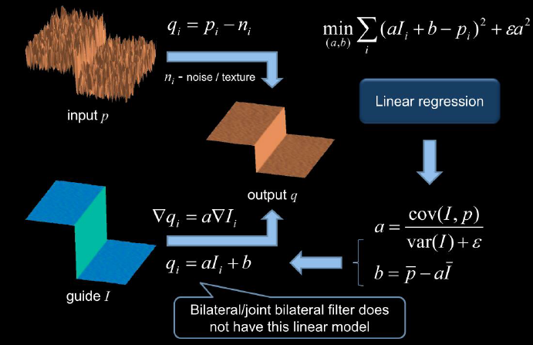
Guided Filter as an Edge Preserving Filtering

Slide 3


Guidance Image I
Input Image p
Output Image q
I & p might be the same

Slide 4
Key assumption of guided filter is a local linear model between the guidance I and and the filtering output q
Where a,b are some linear coefficients assumed to be constant in window
This means, the local linear model has edge only if I has an edge

Slide 5

So, we have to estimate a , b using guidance image I in every local patch(window)
The paper defines the objective function as above
(minimize difference between p&q while maintaining
Local linear model,epsilon used to penalize large a)

Slide 6




Using linear ridge regression model….
However, a pixel I is involved in all the overlapping window that covers I,so we simply average all possible value of q!!

Slide 7


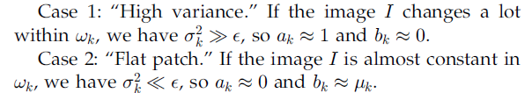
So , how can this have Edge-Preserving Property?
Consider….

Slide 8
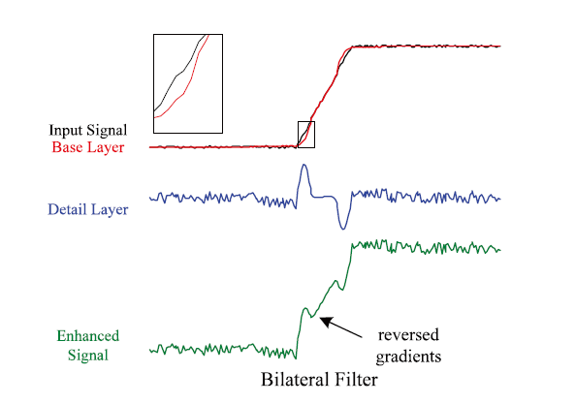
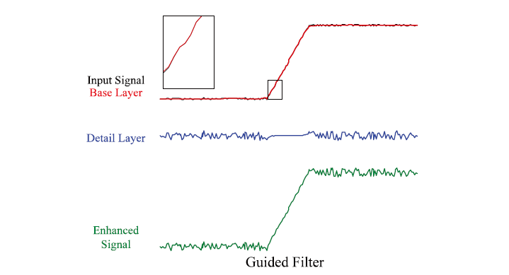
So,how can this avoid gradient reversal

Slide 9

But now , we have
Because a b vary spatially
But, a b are low-pass filter maps(average output, gradient can be expexted to be much smaller than that of I near strong edges
Avoid gradient reversal

Slide 10

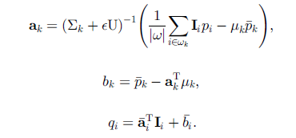
Extend to Color Guidance Image

Slide 11
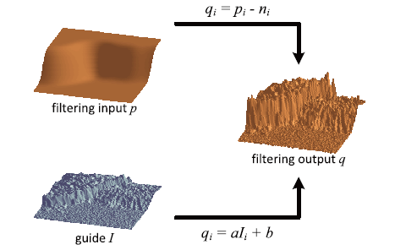
Guided Filter~
˙Has naïve O(n) time complexity , using Integral Image Techniques
˙Lots of application , Edge-Preserving Smoothing、HDR Compression、Detail Enhancement、Flash/no Flash Photography、
Image Feathering、Haze Removal…

Slide 12
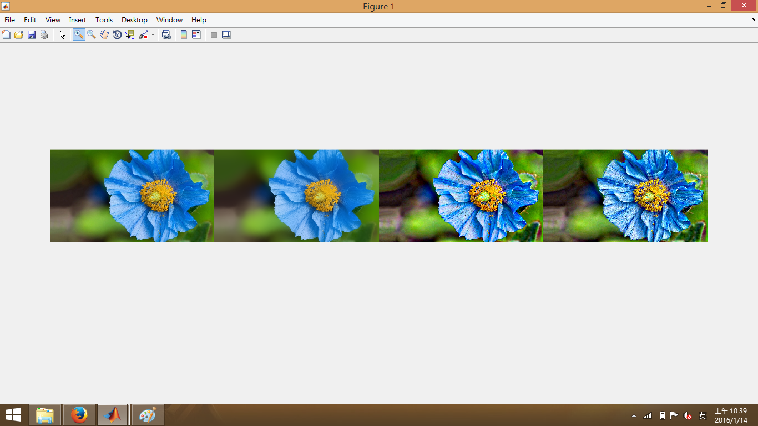

Slide 13
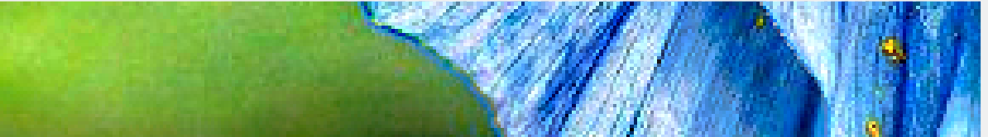
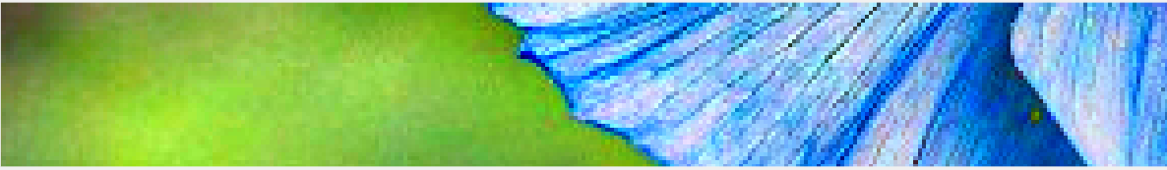

Slide 14



Slide 15
DEMO TIME

